Slide 1
PepsiCo Data Science Challenge
Christopher Cammilleri

Slide 2





My Solution
Data Pre-Processing
Exploratory Data Analysis
Data Cleaning/Feature Engineering
Model Building
Final Analysis/Conclusion

Slide 3
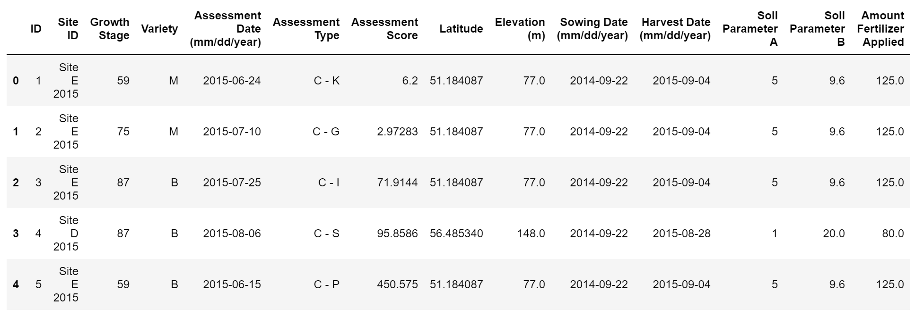
Data Pre-Processing
Loaded excel data into Pandas Dataframe
Merged Crop Grain Data and Site Data in to one Dataframe
Replaced ‘*’ assessment scores as NaN

Slide 4
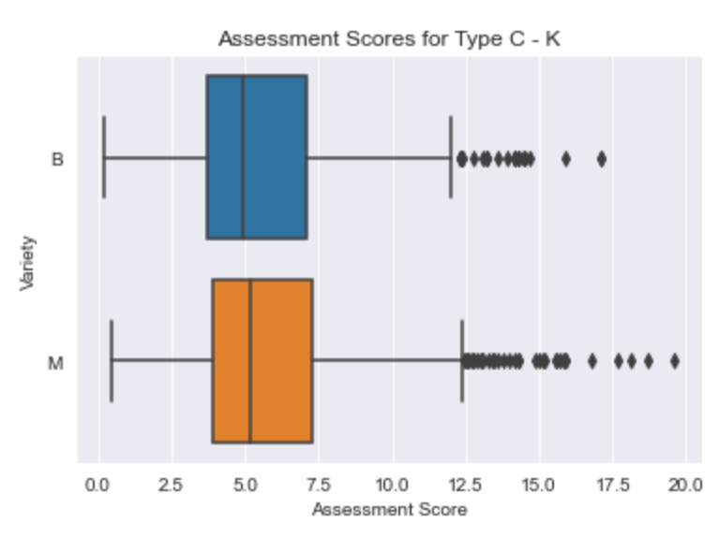
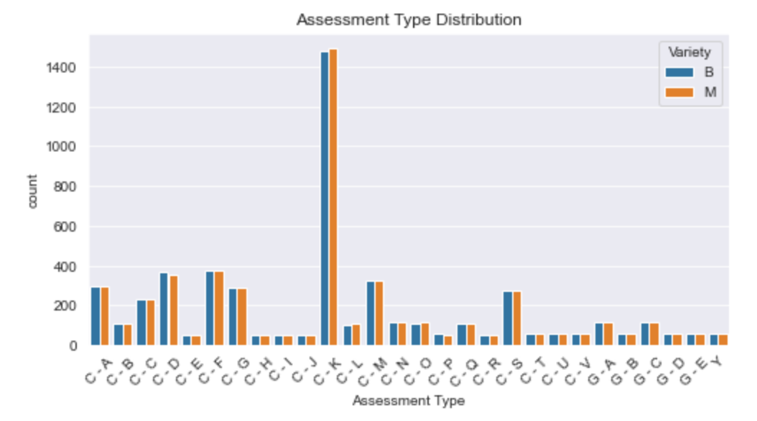
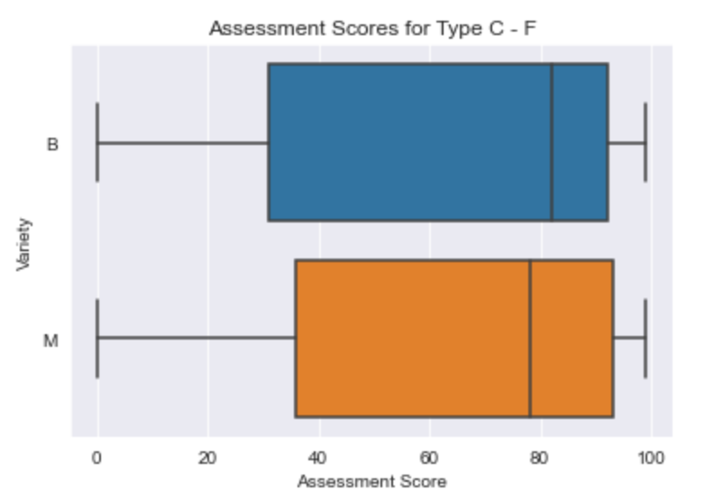
Exploratory Data Analysis

Slide 5
Data Cleaning/Feature Engineering
Weather Data
Feature Engineering/Data Cleaning
Machine Learning Preparation
Computed summary statistics for weather reports during crop’s life cycle:
- Mean
- Standard Deviation
- Minimum
- Maximum
- 25th, 50th, 75th percentile
- Number of days between Assessment Date, Harvest Date, and Sowing Date
- ‘Site’ column – year neglected
- Parsed year, month, weekday, day from date columns
- Scaled continuous features
- Converted categorical columns to ‘dummy’ columns
- Split data into train set and test set

Slide 6
Model Building
Four models trained for this task
GridSearchCV used to tune hyperparameters for each model
Mean Absolute Error used for scoring
Lasso
K-Neighbors
Random Forest
Support Vector
Alpha: .001
Train MAE: 21.59
Test MAE: 22.00
N_neighbors: 11
Weights: distance
Train MAE: 4.22
Test MAE: 6.07
Max Depth: 64
Train MAE: 4.27
Test MAE: 6.03
Kernel: linear
C: 1
Train MAE: 24.33
Test MAE: 24.55

Slide 7
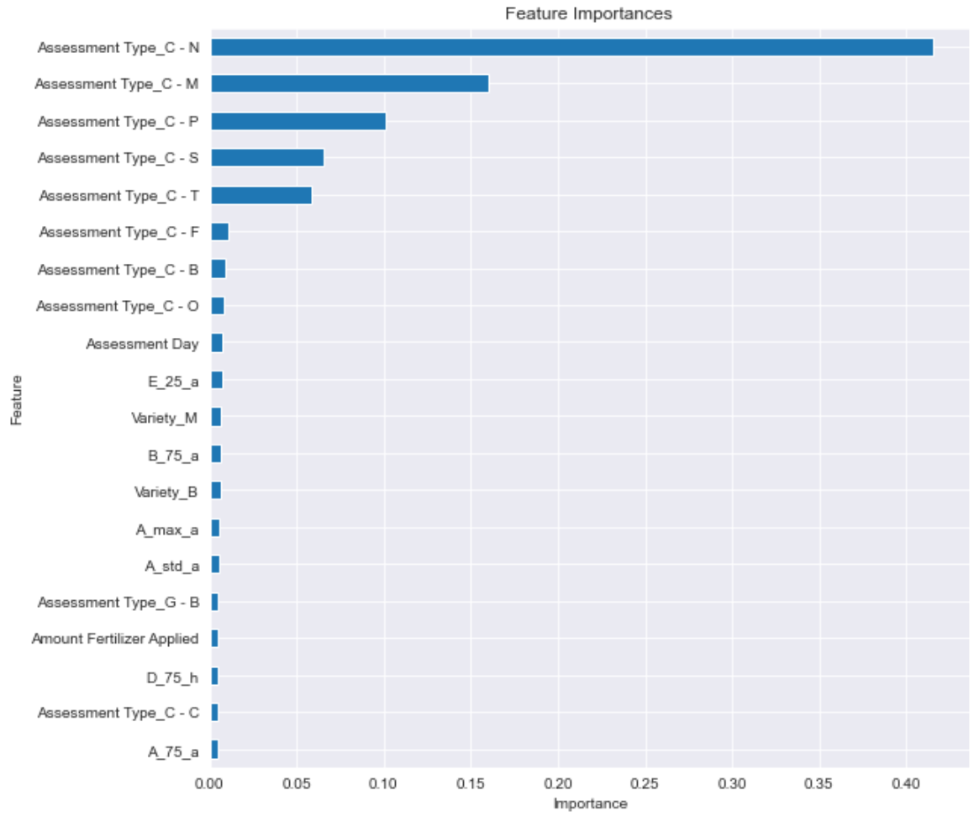
Final Analysis/Conclusion
Best preforming model was Random Forest
Trained model on entire dataset
Observed most important features
Made final predictions
Overall MAE: 4.38

